Slide 1
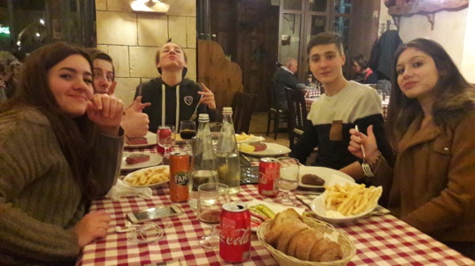
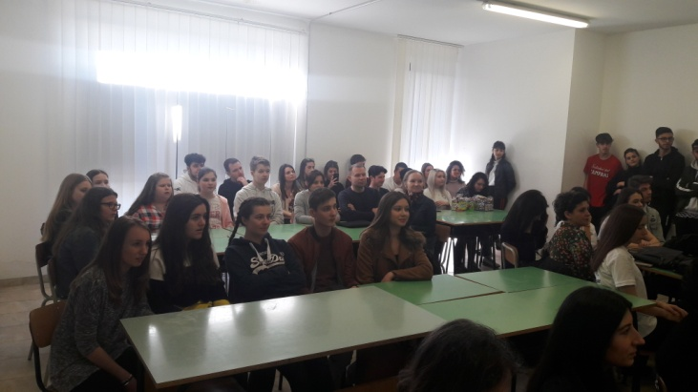
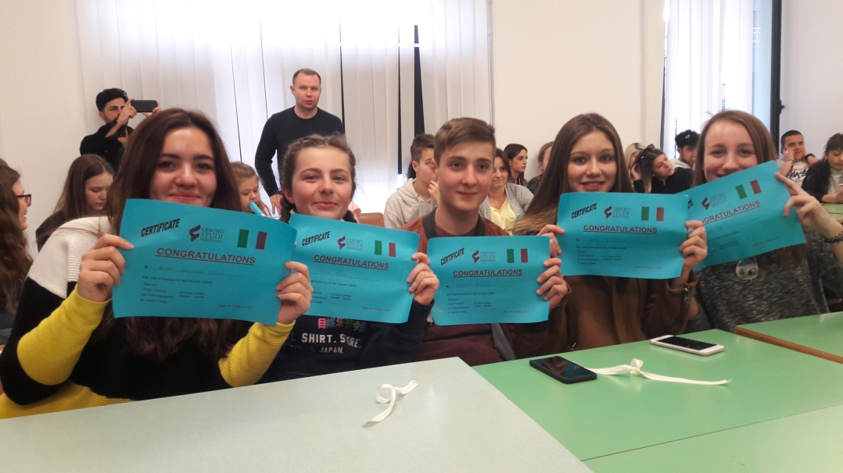
Erasmus project -first trip French team in Italy- from 03/12/18 to 03/17/18(13 au 18 mars)
Centro Studi Frentano srl
Via Ciccarone, 262
The international students' teams

Slide 2
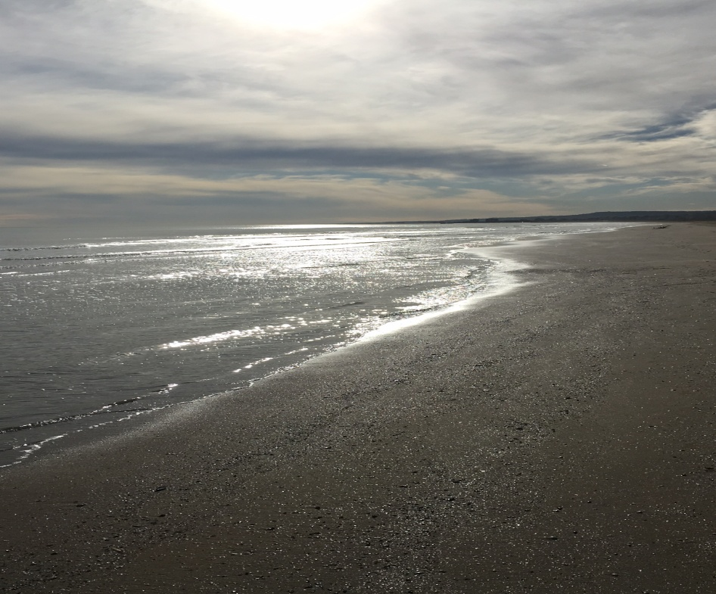
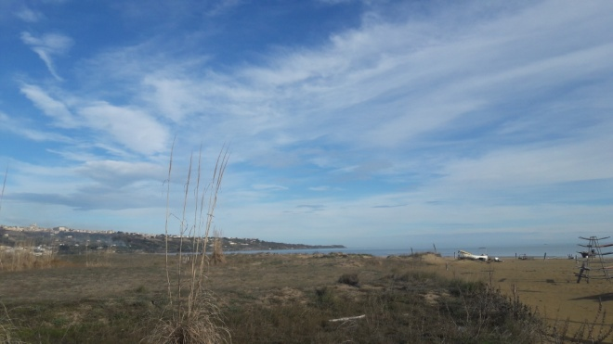
Arrival at Vasto
On Monday, we arrived in Roma, discovered the hotel in Vasto and went for a walk on the beach.
Roma from the sky

Slide 3
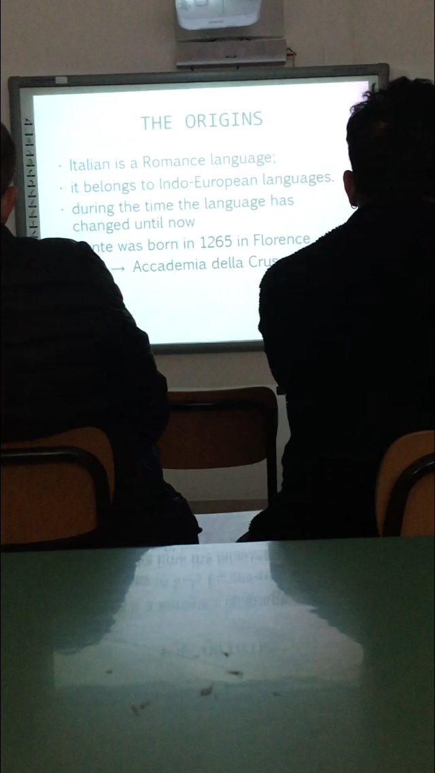
Centro Studi Frentan
On Tuesday, we met the members of the other groups and made our presentations, talked about migrations in our own country.
Leaving for high school
Italian’s presentation

Slide 4
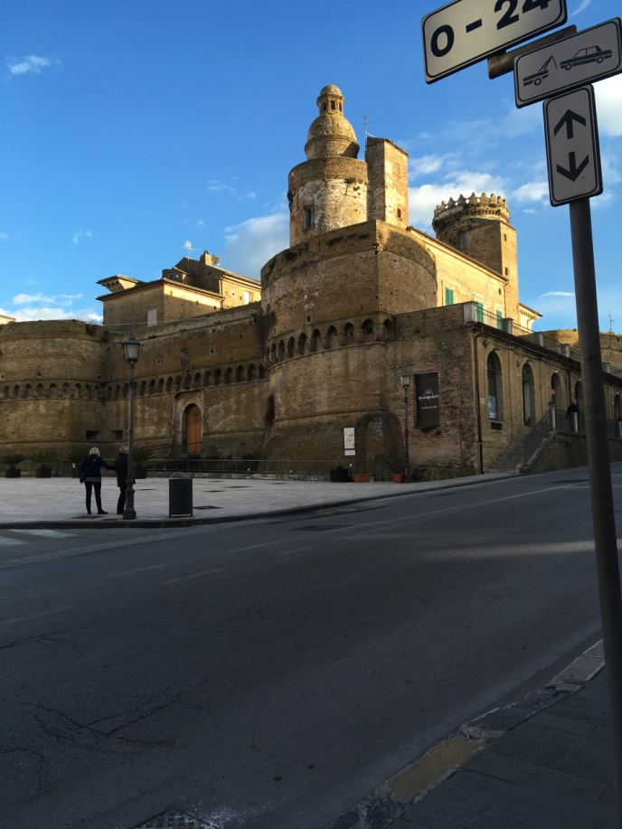
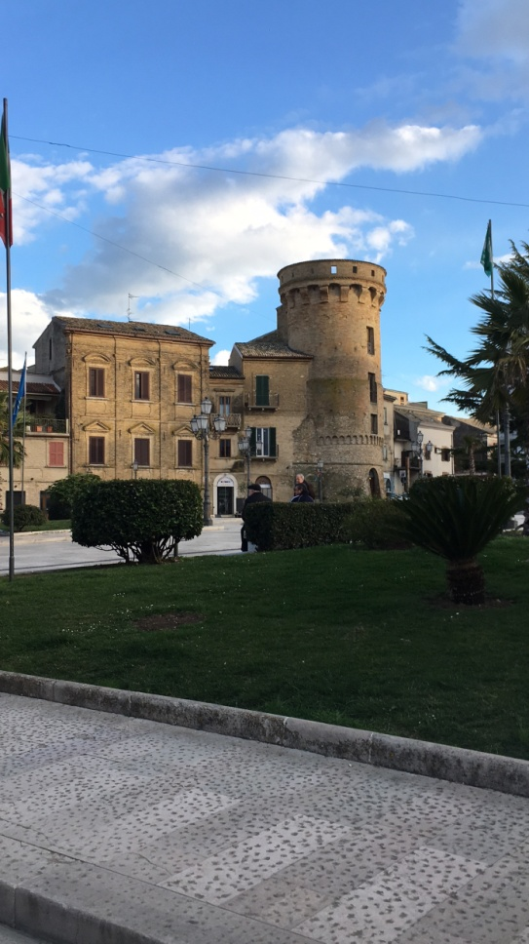
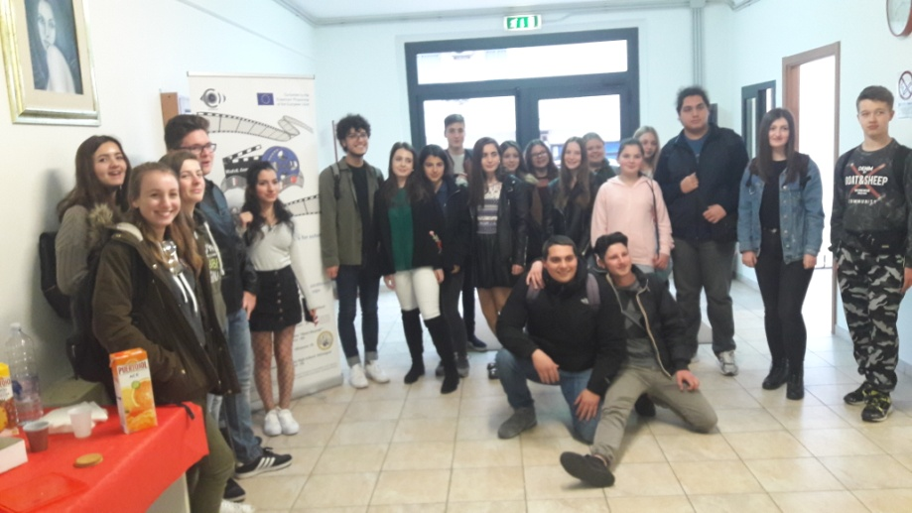
We ended with the visit of the city all together.
First visit of Vasto, its monuments,
Meeting with other countries

Slide 5
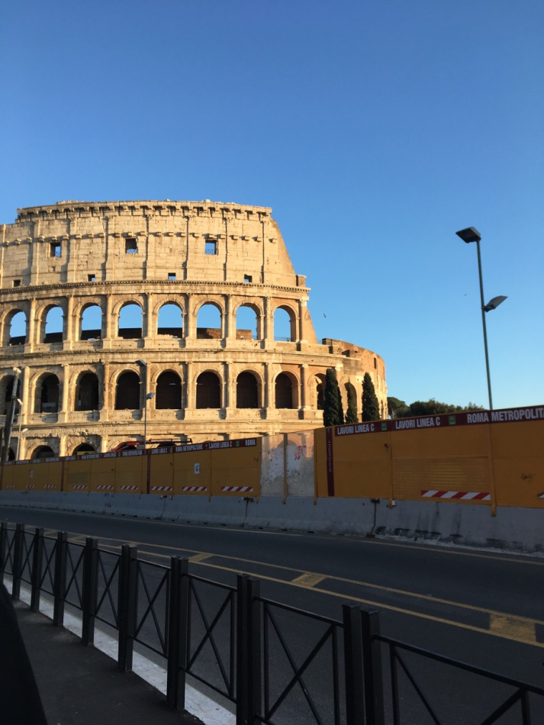
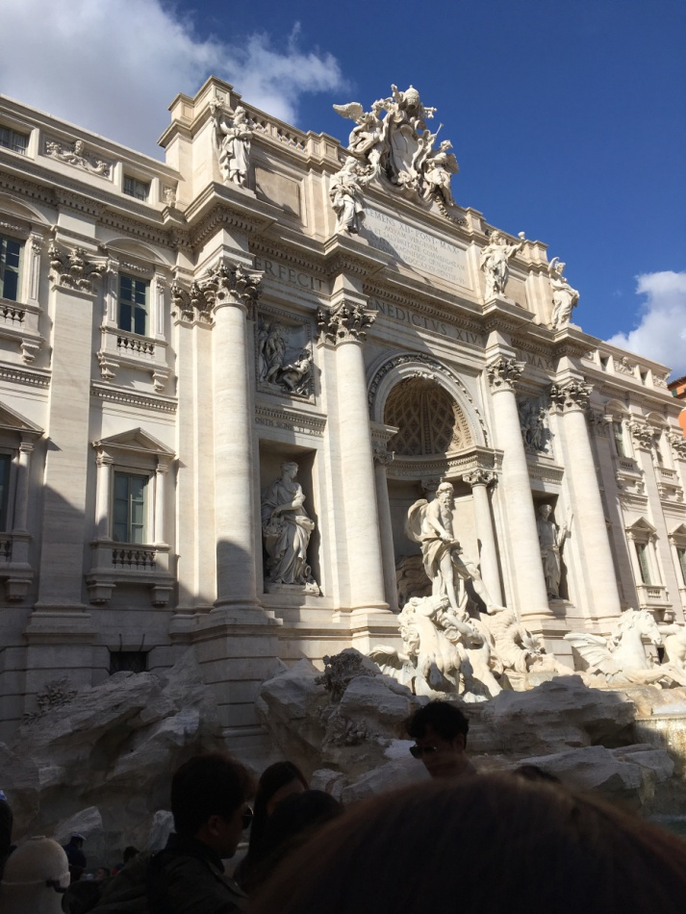
Roma visit
On Wednesday, we visited Roma where we met various migrants and see how they lived.
The Coliseum
Trevi Fountain

Slide 6
Italy and migration
We watched a movie about the immigration of a young African.
Un altro mondo by Silvio Muccino.
Then, we met a cameraman to discover the different ways of filming future short films.

Slide 7
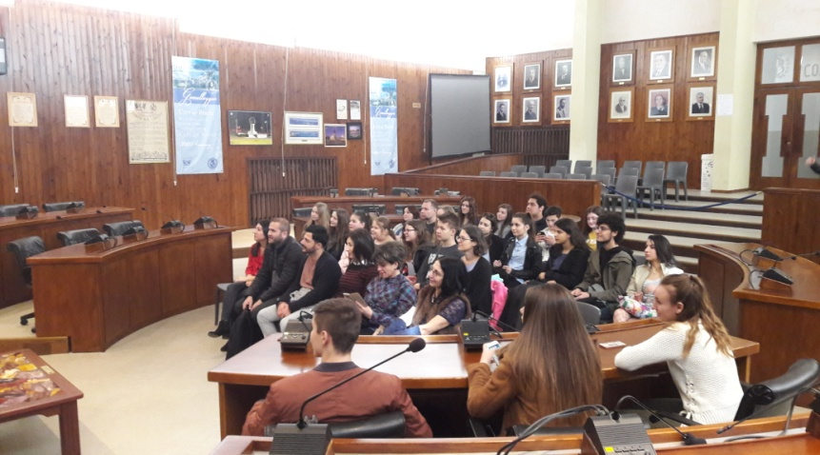
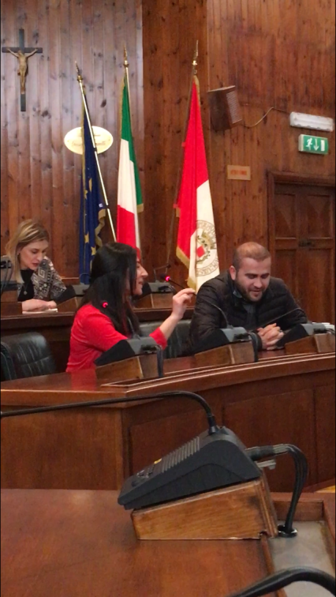
Vasto Townhall
We met the mayor of Vasto, visited the town hall and several museums.Finally, we organized a farewell party.
Farewell dinner
Visit to the townhall of Vasto

Slide 8
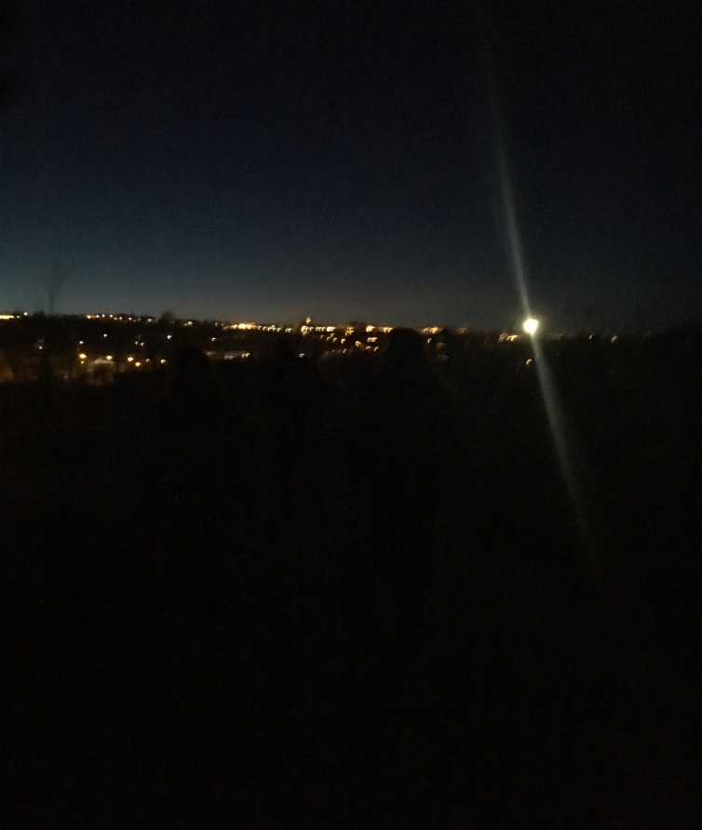
Saturday
We prepared the departure and then made a debrief and goodbye meeting.
Goodbye Vasto…

